Slide 1
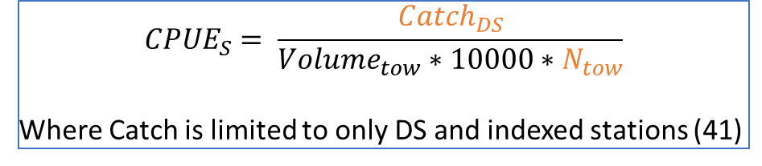
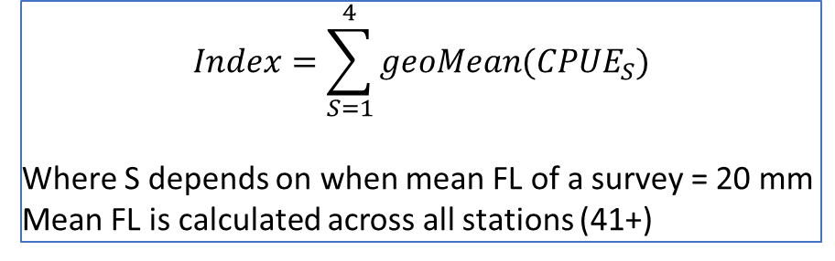
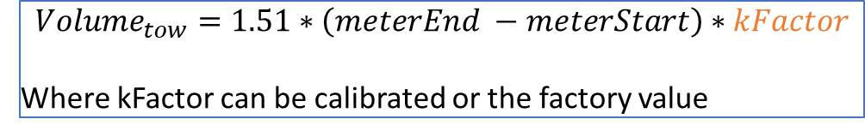
$$Index=\sum_{S=1}^{4}{geoMean({CPUE}_{S})}$$
Where S depends on when mean FL of a survey = 20 mm
Mean FL is calculated across all stations (41+)
$${CPUE}_{S}= \frac{{Catch}_{DS}}{{Volume}_{tow}∗10000∗N_{tow}}$$
Where Catch is limited to only DS and indexed stations (41)
$${Volume}_{tow}=1.51∗\left(meterEnd −meterStart\right)∗kFactor$$
Where kFactor can be calibrated or the factory value
Here, variables that are orange are those that require further clarifications

Slide 2
Index difference: causes
Geomean Different
Mean fork length
4 Index Surveys
Indexed Station
Survey 1 ignored
CPUE
Subsample
Volume
Catch
NTows
kFactor
Calibrated
Factory

Slide 3
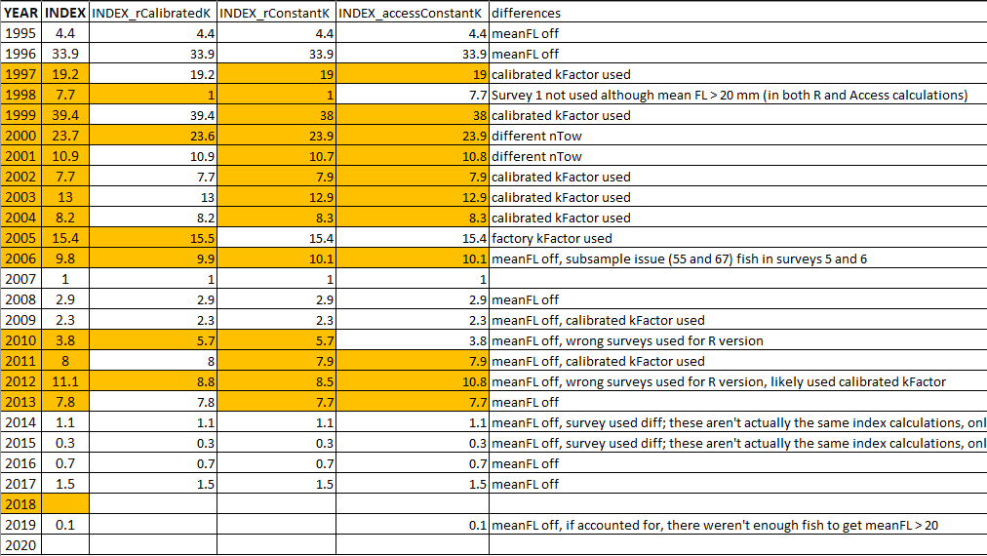
Notes:
Check to see if subsampling actually occurred in 2006s; total length vs fork length (should be using FL)

Slide 4
Questions to be answered
Were calibrated k factors used to calculate the indices over the years? Access queries seem to only use the factory k factor(qry_AMC_Index 01 and 02, or qry_TLT_Index 01 and 02).
Should index stations be used to calculate mean forklength of a survey to find the 20 mm threshold?
Currently, number of catch is limited to only indexed stations but not mean FL
How should surveys with mean > 20 mm that occurs early in the season and due to low catch be treated?
How should subsampling be accounted for when calculating catch
Can a tow 3 occur without a tow 2?

